Slide 1
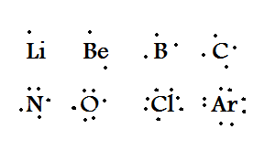
LEWIS ELECTRON STRUCTURE

Slide 2
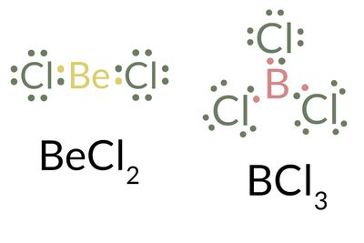

Slide 3
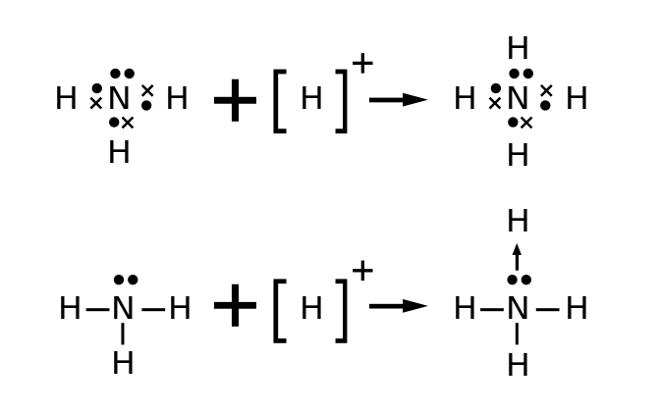

Slide 5
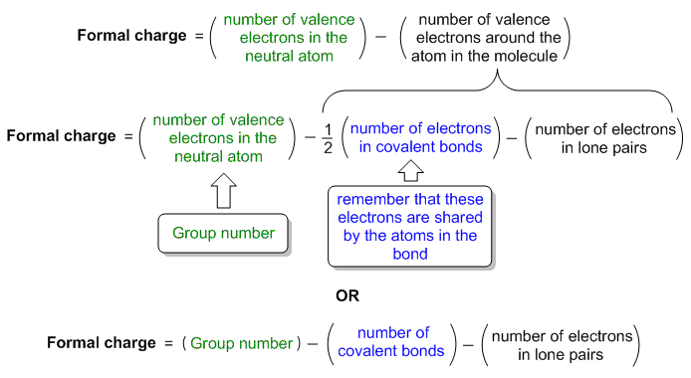

Slide 6
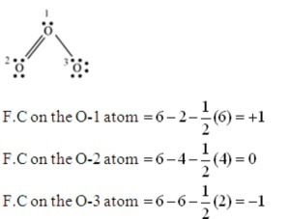

Slide 7
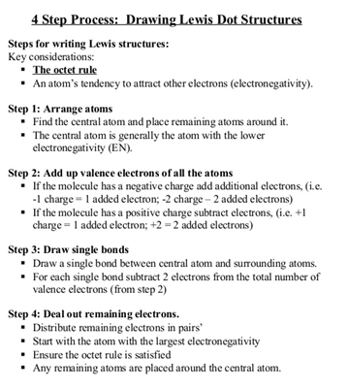

Slide 8
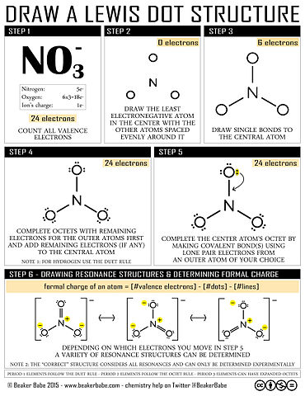

Slide 9
DRAWBACKS OF OCTET RULE

Slide 10
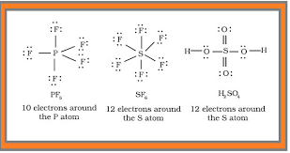
EXPANDED OCTET

Slide 11
ODD ELECTRON PAIR

Slide 15
